Slide 1
Research on MNIST handwritten digits dataset by applying MLP
Presenter: Dongxiao Ma，Jiajian chang，Chenyin Yu

Slide 2
Introduction
Handwriting digits recognition is the ability of a computer system to recognize the handwritten inputs like digits, characters etc. from a wide variety of sources like emails, papers, images, letters etc. This has been a topic of research for decades. The most popular handwriting digits dataset is the MNIST database

Slide 3
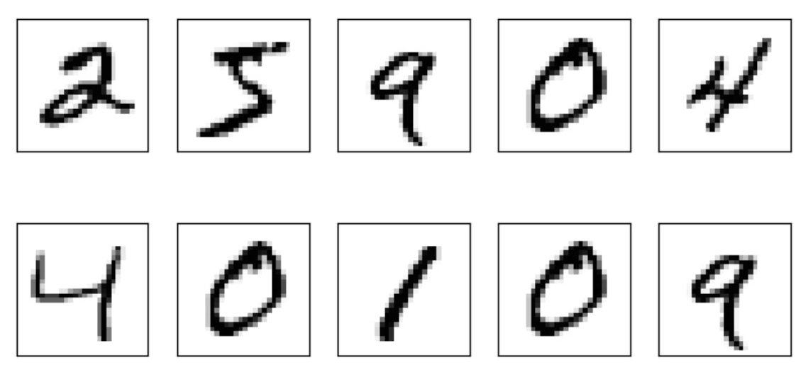
Mnist Database of handwriting digits
MNIST(the modified National Institute of Standards and Technology) dataset was constructed from NIST's Special Database 3 and Special Database 1 which contain binary images of handwritten digits. The MNIST training set is composed of 30,000 patterns from SD-3 and 30,000 patterns from SD-1. Our test set was composed of 5,000 patterns from SD-3 and 5,000 patterns from SD-1. The 60,000 patterns training set contained examples from approximately 250 writers.

Slide 4
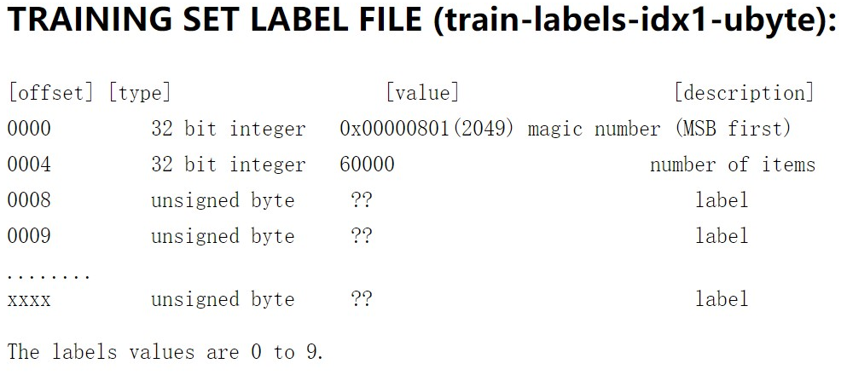
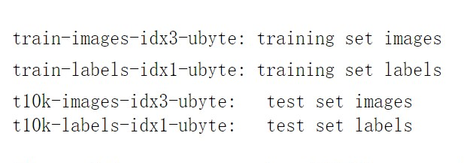
MNIST Dataset File
File format : High endian(Binary Format)
Magic Number : Check File
Offset : Position of data to start with

Slide 5
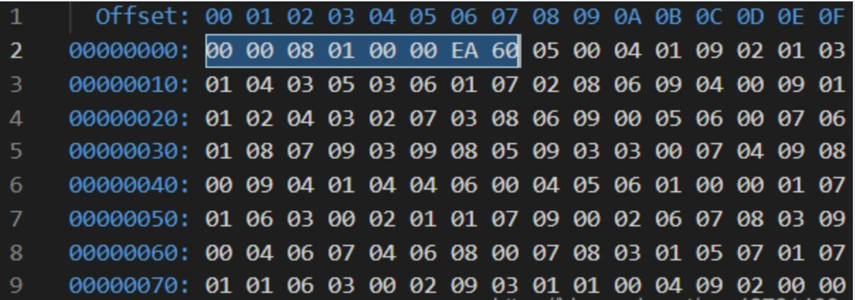
Image file
All data integer is among 0(White) and 255(Black)
Offset : 16
Format : 28 X 28
Label file
All data integer is among 0 and 9
Offset : 8
Format : One integer

Slide 6
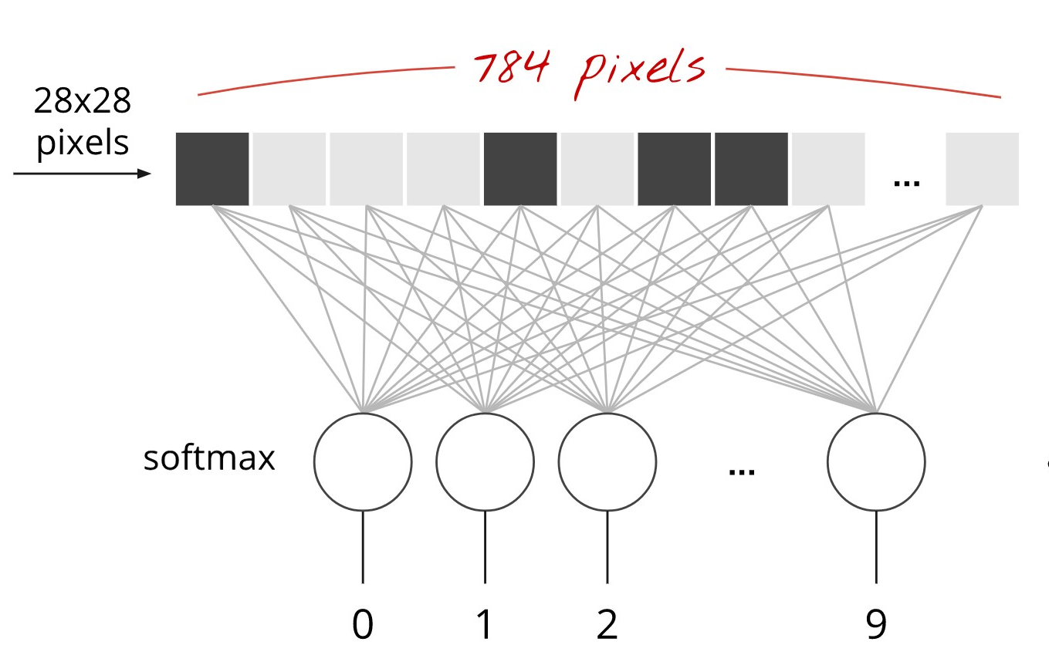
Multiple layer perceptron neural net work
Problem type : classification
Classes : 10
Input format: 1X 784 vector
Batch Size: 100 input
Output format: 1X 10 vector(Outcome probability distribution)
Target format: 1X 10 vector(One hot encoding)
Cost function: Cross entropy
Accuracy: 91.4%

Slide 7
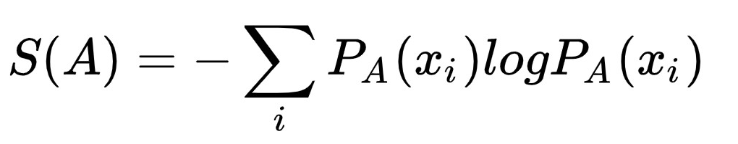
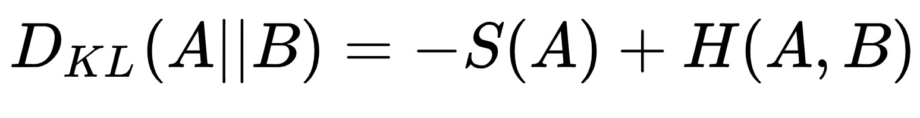
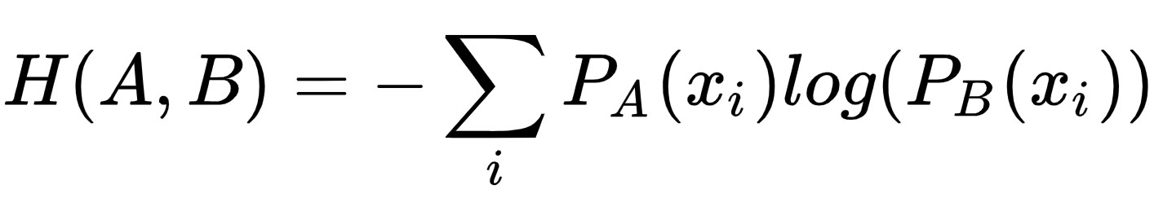
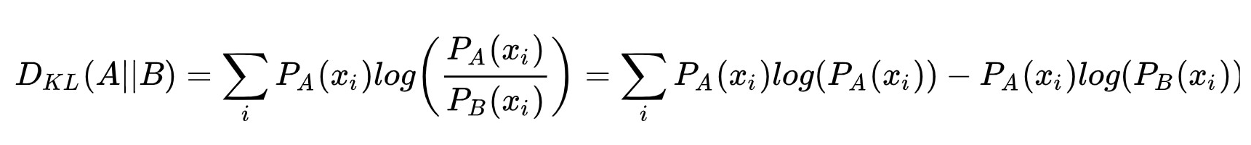
KL-Divergence: Similarities between to distribution.
If the p(x) fix, the cross entropy will be change with the KL-Divergence. Hence, the cross entropy represent the KL-Divergence.
Entropy
KL-Divergence
Cross Entropy
KL-Divergence

Slide 8
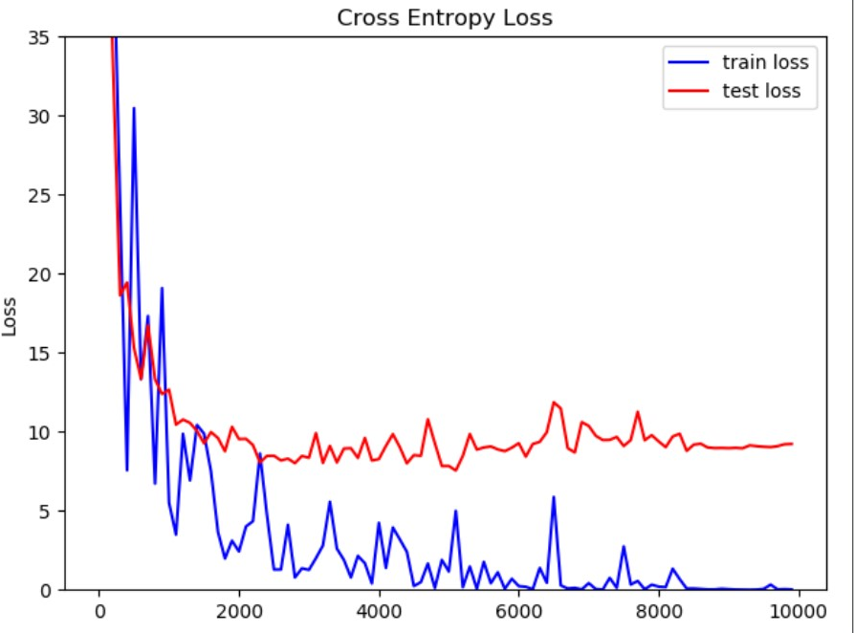
Four layers NN
1.First layer consists of 200 neurons. Weight is a 784 by 200 matrix, the bias is a 1 by 200 matrix.
2.Second layer consists of 100 neurons. Hence, the weight is a 200 by 100 matrix, the bias is a 1 by 100 matrix.
3.Third layer consists of 50 neurons. Hence, the weight is a 100 by 50 matrix, the bias is a 1 by 50 matrix.
4.The fourth layer consists of 50 neurons. Hence, the weight is a 50 by 10 matrix, the bias is a 1 by 10 matrix.
Accuracy: 98.1%

Slide 9
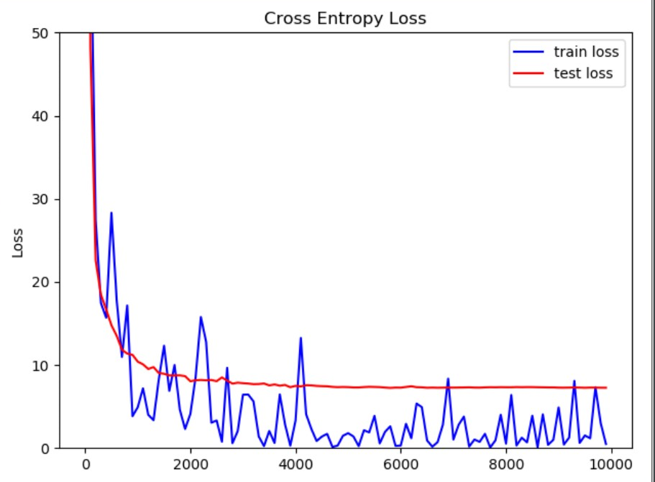
drop out rate: 0.33
decay function: 0.00001 + 0.003 * (1/e)^(step/1500)).
Range(0.003,0.00003)
Accuracy: 98.12%

Slide 10
Result
We construct five layers with more neurons, the accuracy still remains in 98% level. There is no more features to extract. The reason is that we flatten the image into a vector. We only consider the relationship in rows, not both in rows and columns. In the other word, the shape feature of the image is ignored. If we want to improve the accuracy, we should utilize other architecture and algorithm.

Slide 11
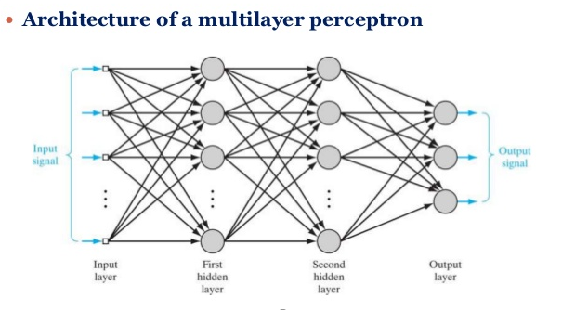
The MLP architecture and data processing
MLP
A MLP consists of at least three layers of nodes: an input layer, a hidden layer and an output layer. It can distinguish data that is not linearly separable.

Slide 12
The MLP architecture and data processing
MLP
Basic features:
1、Each neuron in the network includes an activation function that is differentiable .
2、The network contains one or more hidden layers.
3、The network exhibits a high degree of connectivity.

Slide 13
The MLP architecture and data processing
Data processing
The data can be gathered from the website http://yann.lecun.com/exdb/mnist
Thanks for the Keras library, the data has been collected and is already well-formatted for processing by applying two-line python codes.

Slide 14
The MLP architecture and data processing
Data processing
MLP does not recognize such things as ‘2D’.
It means the input data must be a vector. Instead of several 28 * 28 pixels image, we translate them that are all same length 784 (28 *28 = 784).

Slide 15
One-hot encoded labels
One-hot
The MNIST labels, which are just numbers (and numbers can take any value), are not categorical.
Thus, when we’re making predictions about categorical data (as opposed to values from a continuous range), the best practice is to use the ‘one - hot’ encoded vector.

Slide 16
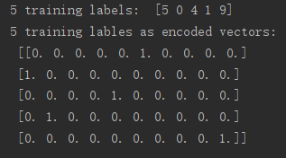
One-hot encoded labels
One-hot
For example, we create a vector as long as the number of categories we have, and force the model to set exactly one of the positions in the vector to 1 and the rest to 0.

Slide 17
One-hot encoded labels
One-hot
Why we use one hot. Because it is a more reasonable way to calculate the similarity & difference of features in Euclidean space.

Slide 18
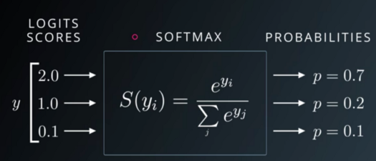
SoftMax activation function
Softmax activation function
The output layer data through the softmax activation function will become the probabilities.

Slide 19
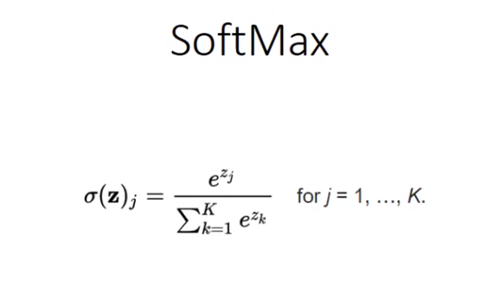
SoftMax activation function
Softmax activation function
Softmax is usually used in multi-classify problems which are based on the probablity distributionm and this is useful for finding out the most probable occurrence or the classifcication where the probablity of a class is maximum.

Slide 20
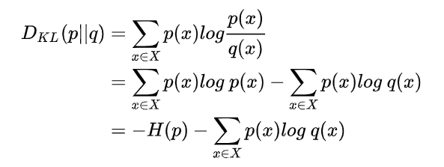
cross entropy loss function
Cross entropy- Kullback-Leibler Divergence
Before we talk about the cross entropy, we have to introduce some background knowledge like the Kullback-Leibler Divergence, which is used to measure the distance of two distributions.

Slide 21
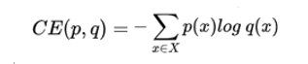
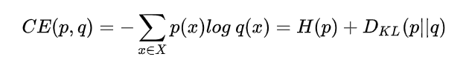
cross entropy loss function
Cross entropy function
In function two, the H(p) means the entropy, we estimate there are two distributions, the cross entropy of them in the given sample space can be defined as

Slide 22
Cross entropy
Back to our MLP, the true label can be seen as p(x) and predicted label (output layer) is q(x), after the one-hot encoded version transfer, it becomes a vector with ten features like [0. 0. 0. 0. 0. 1. 0. 0. 0. 0.], the sum of the probability is 1, [0. 0. 0. 0. 0. 1. 0. 0. 0. 0.] shows it belongs to class 5, meanwhile, data go through the SoftMax classifier is also a probability distribution, this is the output layer, it may look like [0.05, 0.06, 0.06, 0.22, 0.51, 0.13, 0.01, 0.02, 0.03, 0.15], the sum of [0.05, 0.06, 0.06, 0.22, 0.51, 0.13, 0.01, 0.02, 0.03, 0.15] is 1 as well. By putting these two one-dimension vectors into the cross entropy function, we can get the value of the cross entropy, the smaller means the higher match accuracy between the prediction and the truth.

Slide 23
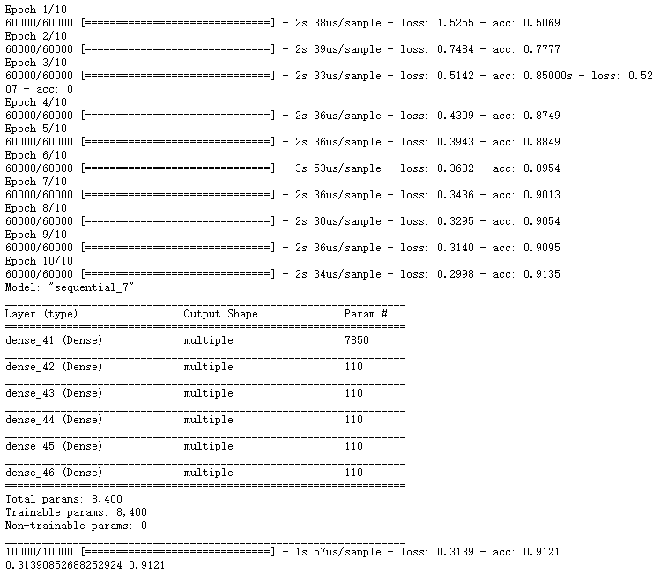
Visualization of accuracy and loss for the training dataset evaluation
MLP which has 5 hidden layers with 10 neurons each layer

Slide 24
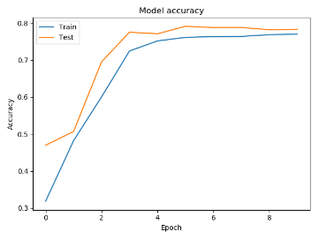
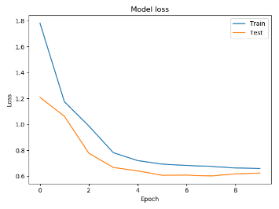
Visualization of accuracy and loss for the training dataset evaluation
MLP which has 5 hidden layers with 10 neurons each layer

Slide 25
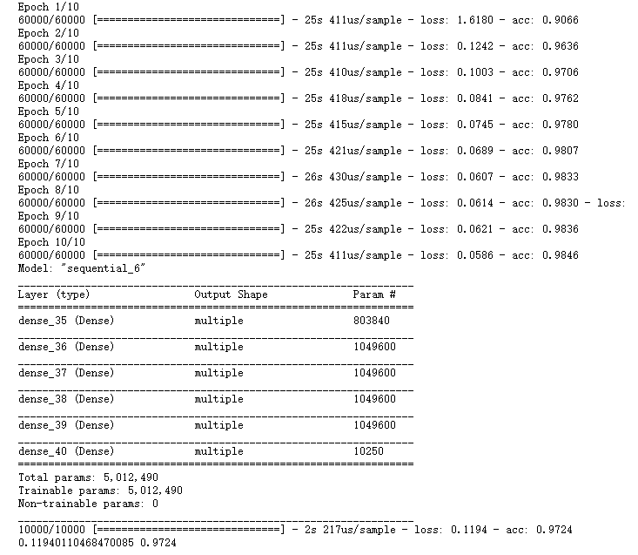
Visualization of accuracy and loss for the training dataset evaluation
MLP which has 5 hidden layers with 1024 neurons each layer

Slide 26
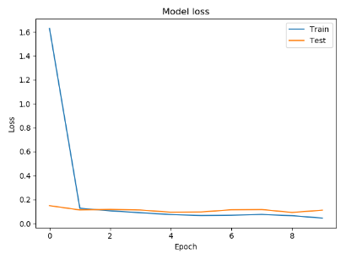
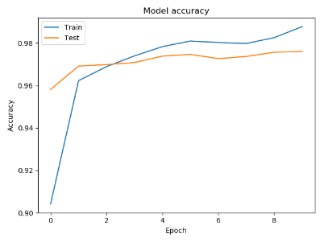
Visualization of accuracy and loss for the training dataset evaluation
MLP which has 5 hidden layers with 1024 neurons each layer

Slide 27
Hand Written Digit Recognition Based on Support Vector machine
Chen-Yin Yu

Slide 28
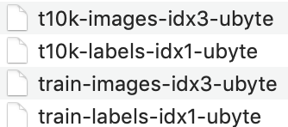
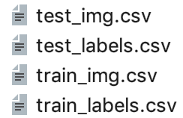
Store and Visualize the Dataset
visualize the Mnist data
read as numpy & save as csv format

Slide 29
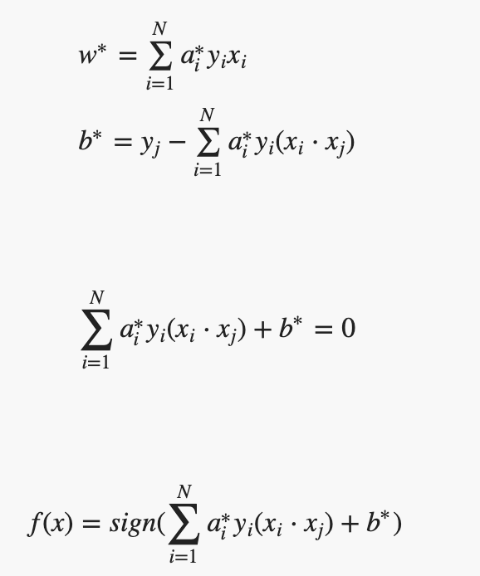
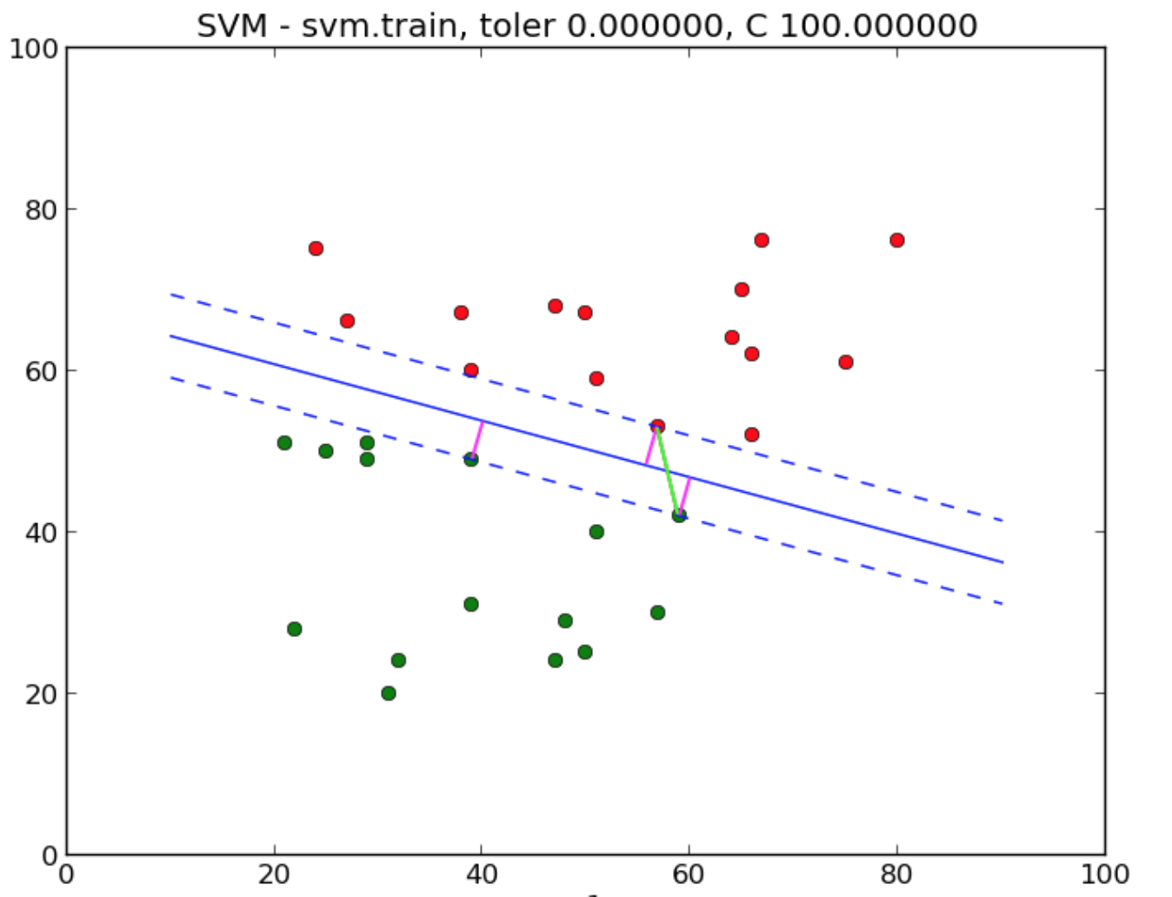
Linear Support Vector Machine
two-class classifier
find the separation hyperplane
a is the Lagrange factor
N is the number of samples

Slide 30
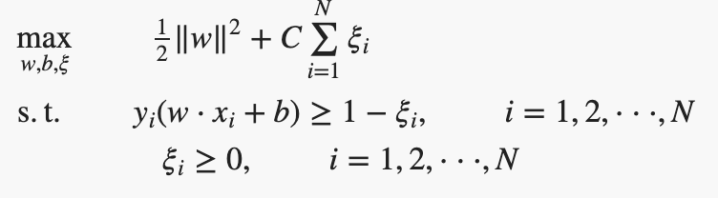
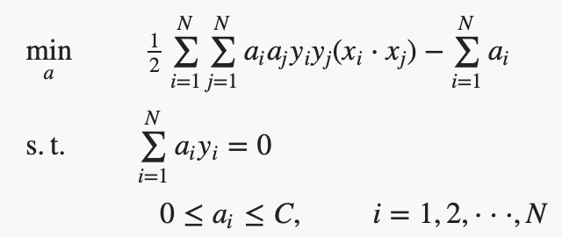
Linear Support Vector machine
slack variable $ξ ;$C is penalty parameter.
The objective function needs to pay C for each $ξ$

Slide 31
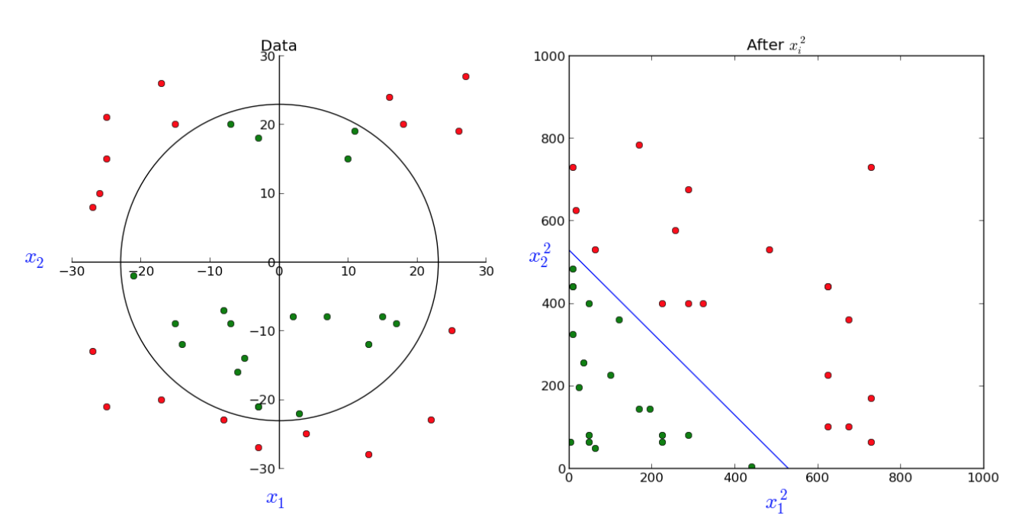
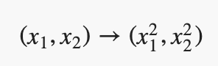
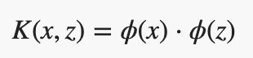
Support Vector machine
Mapping function φ(x)
Kernel function K(x,z)

Slide 32
Support Vector Machine
Kernel function replacement xi⋅xj

Slide 33
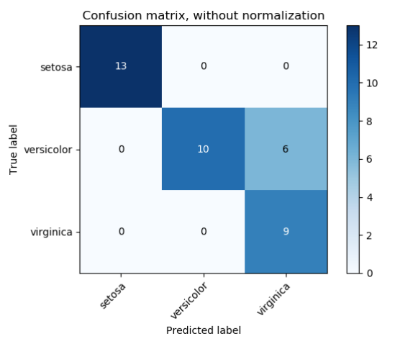
Confusion Matrix
row is true value
column is the predicted value

Slide 34
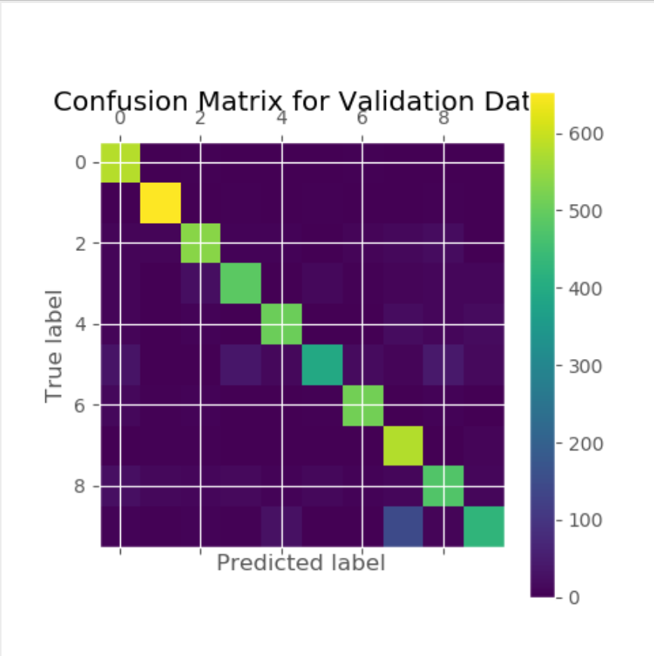
Confusion Matrix Conclusion
Linear SVC
1 has the highest accuracy rate
5 has the lowest correct rate and is easily recognized as 0, 3, 8
9 is easily identified as 4 & 7

Slide 35
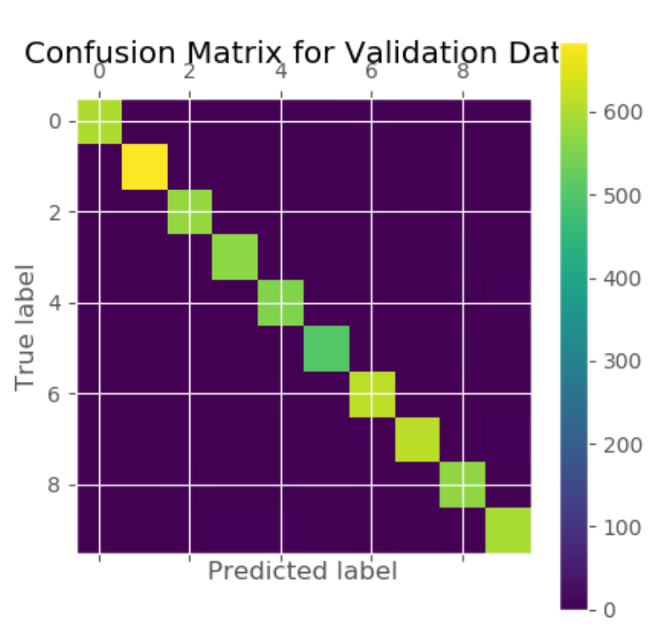
Confusion Matrix Conclusion
SVC
not much difference on 0,1,2,7
but the accuracy of other numbers has been greatly improved.

Slide 37
Advantages of SVM
Using inner product kernel function instead of nonlinear mapping to high dimensional space
Simplifies common classification and regression issues
A few support vectors determine the end result, which helps us capture key samples

Slide 38
Disadvantages Of svm
SVM algorithm is difficult to implement for large-scale training samples
Running time is very expensive

